Slide 1

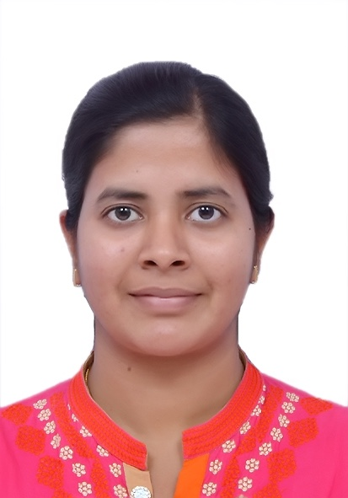
KYNDRYL CTO CoE - Talent Profile
Bio Synopsis
Certifications
16 years of work experience in IT industry working primarily as full stack software developer having experience of software life cycle development in developing product software and automation software. Technological forte includes Java Spring boot, J2EE, Python, Kafka, Ansible, DevOps, API programming, ReactJS/Hibernate/EmberJS.
Key areas of experience have been project research, innovation, requirements analysis, development, delivery, preparing technical specifications, release management, application enhancements and supports.
AZ900 - Microsoft Azure Fundamentals Certification
Advanced Automation (D0477) - Red Hat Ansible Best Practices
Awards
Shruti Modi
Senior Lead, Software Development - Application
Based in Bangalore India
Overall 16 years of experience in leading digital transformation and hybrid cloud modernisation through Infrastructure as Code (IaC), automation, and enabling technologies in Application and DevOps.
shruti.modi@kyndryl.com
Industry Expertise
Domain Expertise
CTO CoE Client based Led Innovation Award
Many Special Initiative awards for process improvement plans, on the spot awards and beyond performance award
Received star of the month award for working in multiple projects and delivering quality deliverables.
IT Industry - Kyndryl, IBM, TCS
Banking - RBiH
Government - eGovernance of Karnataka
Railway - BNSF
Aviation – Bangalore International Airport Ltd
Education – Jain University
API Manager - WSO2
Expertise in advising, designing, and implementing Infrastructure as Code (IaC) solutions — leveraging Terraform, Ansible to automate and modernize complex IT environments.
Skilled in developing scalable applications with Java/J2EE, Spring Boot, Python and microservices architecture.
Strong experience with Ansible and Ansible Tower for automation, orchestration, and deployment.
Proficient in front-end technologies ReactJS and EmberJS, and backend solutions with Hibernate.
Experience with Jenkins, Git, and Slack to implement CI/CD pipelines and improve DevOps workflows.
Hands-on expertise with containerization technologies like Docker, Kubernetes, and RedHat OpenShift.
Familiar with cloud monitoring tools like Grafana and ELK Stack for performance tracking and issue resolution.
Education & Affiliations
Key Projects Experiences
Worked extensively on designing & implementing microservices for LMS and Communication System of Jain University
Designed and Developed a United Lending Interface (ULI) platform API for RBiH using Java Spring Boot & Microservice architecture.
Created solutions to integrate vCenter alarms with ServiceNow incidents through Ansible.
Designed a user-friendly interface to enhance user experience for the BIAL MVP project.
Lead Solution Architect for client eGovernance (Karnataka).
Established automation to convert Lenovo XClarity alerts into ServiceNow incidents using Ansible playbooks.
Automated server decommissioning across various infrastructures with rollback mechanisms through Ansible playbooks.
Developed new features and containerized the framework, implementing DevOps pipelines for cloud solutions.
Led development efforts for the NETGEO application using Google Maps API.
Enhanced BNSF desktop applications and conducted data analytics on authoritative sources.
Yashwantrao Chavan College of Engineering, Nagpur BE, Computer Technology (2005 - 2009)

